Slide 1

Deep Learning Techniques for Forecasting Electrical Loads
Presented By:- Tolulope Olugbenga

Slide 2
Introduction
Load forecasting is an important part of electric utility design, planning, and operation, and it has a long history in the power industry.
A critical goal of load forecasting is to ensure that consumers receive an adequate supply of energy in order to maintain supply-demand balance.
While both statistical and machine learning (ML) techniques have been used to forecast load, machine learning algorithms are more intelligent and capable of more accurately forecasting load.
Deep learning techniques have grown in popularity in recent years due to their ability to interpret complex relationships in data more accurately.
The goal of this research was to compare deep learning forecasting techniques to some conventional forecasting techniques currently used by various utilities to see if deep learning can better meet their needs.

Slide 3
Deep Learning Techniques - Introduction
Deep learning is a subfield of computer science that allows computer models to learn to represent data at various levels of abstraction.
Deep learning refers to the process of increasing the depth of a network in order to reduce generalization error, rather than simply increasing the size of a single hidden layer.
Deep learning has transformed fields like image processing and sequence learning by producing more powerful outputs than traditional benchmark neural networks.
Deep learning models have gained traction in fields such as computer vision, speech recognition, machine translation, and board game programming, where they have shown performance comparable to, if not exceeding, that of expert humans.
The most common deep learning techniques are deep neural networks, recurrent neural networks, long short-term memory networks, deep belief networks, and convolutional neural networks.
Deep learning and neural networks are frequently used interchangeably in discussions. A deep learning technique is a neural network with more than three layers.

Slide 4
The Myth of the One-Size-Fits-All Technique
Tao Hong discussed the myth of discovering the best technique
He concluded that it is critical that researchers and users understand that there is no such thing as a universally best technique.
The approach to load forecasting should be determined by the forecasting requirements and the dataset being analyzed.
One approach is unlikely to be useful in all load forecasting scenarios. With different datasets, different algorithms perform better or worse.
Furthermore, forecast errors vary significantly across utilities, utility zones, time horizons, and so on.

Slide 5
Load Forecasting Horizons
Electricity demand can be measured hourly, daily, weekly, monthly, or yearly, and forecasting can be done on a variety of time scales: very short-term load forecasting (VSTLF, 1-day), short-term load forecasting (STLF, 2-weeks), medium-term load forecasting (MTLF 3-years), and long-term load forecasting (LTLF >3years).
Most recent research has concentrated on short-term forecasting with time horizons of less than two weeks; it is critical in planning, contingency analysis, load flow assessment, and power system planning and maintenance.
According to Hippert, forecasting short-term load becomes more difficult when the load at a given hour is dependent not only on the load at the previous hour, but also on the load at the same hour on previous days and the load at the same hour on the same denomination day in the previous week.

Slide 6
Factors That Affect the Load Demand
Load demand can be affected by a variety of factors, including the region in question, the type of customers in the region, weather factors (e.g., temperature), the time of day, the day of the week, and other uncontrollable factors (i.e., coronavirus outbreak).
These factors are divided into five categories: historical load, economic load, chronological load, meteorological load, and random load.
The literature employs a wide range of historical load input data, but all agree that some sort of historical load input is required.
Economic factors include capital expenditure in the facility's infrastructure, such as the construction of new buildings, laboratories, and experiments that increase the load on the electric grid.
Economic factors have little impact on short-term load forecasting because they typically affect consumption patterns over a longer period of time.

Slide 7
Factors That Affect the Load Demand
Load can be influenced by seasonal, weekly, and daily cycles, as well as holidays.
Because time influences how electricity is used, calendar data is used to incorporate it into load forecast models.
Variables such as the hour of the day, the day of the week, the month, and the week number are used to account for these patterns.
Temperature is the most commonly used and significant weather variable. Most load forecasting models include one or more temperature-related variables.
Temperature and load have a non-linear relationship.
Other weather variables that may affect the electric hourly load profile include humidity, solar irradiance, wind speed, barometric pressure, and precipitation.
Random factors affecting the electrical load profile are other random disruptions in the load pattern that cannot be described by the preceding factors.

Slide 8
The Benchmark Techniques – Seasonal Naïve Forecaster
The naive forecaster is a simple forecaster based on a random walk model; it is frequently used as a starting point for developing more sophisticated forecasters.
It is used to demonstrate how much value forecasters add in comparison – if a simple naive forecaster outperforms a more complex forecasting model, we know that the complex model adds little value.
According to Bracale et al., "the simplest method to anticipate the next value in a time series is to assume it will have the same values as the current value," which serves as the foundation for the naive forecaster.
The Seasonal Nave Forecaster (SNF) enhances the naïve forecaster by taking seasonal trends into account.
The naive formula uses the most recent observed value as the future value, whereas the seasonal naive formula uses the previous season's value.

Slide 9
The Benchmark Techniques – Seasonal Naïve Forecaster
The SNF can be expressed mathematically using the simple relationship shown below.
We used the previous week's lag for the SNF forecaster in this work.
The SNF forecaster is ideal for making short-term forecasts of variables that are generally stable or vary in a consistent manner.
It is, however, ineffective at forecasting time series data that fluctuate significantly or are susceptible to irregular elements such as temperature.

Slide 10
The Benchmark Techniques – Multiple Linear Regression
Multiple linear regression (MLR) is a popular statistical technique for forecasting load.
The relationships between a continuous dependent variable and one or more independent variables are modeled by MLR forecasters.
Mathematically, an MLR with two independent variables is expressed as:
The accuracy of MLRs is primarily determined by the relationships between the data and the independent variables included.
Increasing the number of relevant independent variables improves predictive accuracy in general, but the improvement eventually becomes negligible.
MLRs, on the other hand, can simulate non-linear relationships but only with explicit user specifications.
Furthermore, MLRs are incapable of learning and adapting intelligently to data changes caused by newer factors.

Slide 11
The Benchmark Techniques – ARIMA Forecaster
Box and Jenkins developed the autoregressive integrated moving average (ARIMA) forecaster in 1970. As a result, it's also known as the Box-Jenkins model.
The ARIMA forecaster is arguably one of the most well-known and widely used statistical forecasting techniques for load forecasting.
This technique family, as the name implies, is made up of three main components: a) a "autoregression" portion that models the series' relationship with its past values (lagged values);
b) a "moving average" portion that models the forecast as a function of past forecast errors (lagged forecast errors); and c) a "integrated" portion that makes the series stationary.
To denote the ARIMA model type, specific integer values are assigned to the parameters. The ARIMA model is denoted by ARIMA (p, d, q).

Slide 12
The Benchmark Techniques – ARIMA Forecaster
The ARIMA model is heavily reliant on historical data quality and data differencing.
Time-series data that has been stabilized by subtracting the observations from the prior values is referred to as stationary data. Differencing is required because linear regression models work best with stationary signals.
The result is an estimate based on a linear combination of weighted differentiated lagged values and lagged errors, as shown in the following equation:
While ARIMA models can be accurate and reliable under the right conditions and with enough data, one of the model's main drawbacks is that the parameters (p, d, q) must be manually set.
Finding the best parameters can be a time-consuming trial-and-error process.

Slide 13
The Benchmark Techniques – ANNSTLF Forecaster
An artificial neural network (ANN) is a computer program that attempts to replicate the network of neurons found in the human brain.
The multilayer perceptron (MLP) is a well-known and widely used type of artificial neural network.
It's a feed-forward network architecture made up of one or more hidden layers of linked neurons.
The popularity of neural networks stems from their ability to discover complex and non-linear correlations in historical data, which is extremely difficult to achieve using statistical techniques.

Slide 14
The Benchmark Techniques – ANNSTLF Forecaster
The ANNSTLF is one of the most widely used machine learning-based load forecasters.
The ANNSTLF-G3 has improved prediction accuracy while also generating economic benefits for several utilities.
According to some publications, the best short-term forecaster is ANNSTLF.
The third-generation design will be used, which combines two shallow multi-layer feed-forward ANNs with a recursive least squares (RLS) combiner.
The base-load forecaster (BLF) is trained to predict regular next-day load, whereas the change-load forecaster (CLF) is trained to predict changes in load demand from day to day.

Slide 15
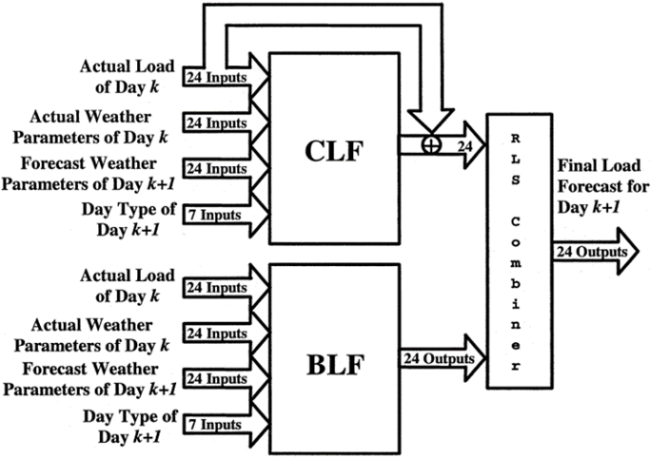
The Benchmark Techniques – ANNSTLF Forecaster
The CLF produces its final output by combining predicted changes with actual last-day values.
The BLF tends to respond slowly to sudden changes in load.
The CLF, on the other hand, responds to changing conditions more quickly because it uses yesterday's load as a baseline and forecasts future changes in that load.

Slide 16
Investigation
The goal of this study was to see if deep learning approaches could improve forecasting accuracy for specific data sets by comparing deep learning forecasters to some of the current forecasters used by utilities.
STLF horizons were the focus of the work because they are an important tool in the day-to-day operations and planning of a utility system.
To do so, a CNN forecaster and an LSTM forecaster were pitted against four benchmark forecasters: an SNF, an MLR forecaster, an ARIMA forecaster, and an ANN forecaster.
For many years, these benchmark algorithms have been available and have been implemented and used by researchers and utilities.
The overall accuracy and peak detection accuracy were compared.

Slide 17
Datasets
Two sets are from an Independent Electrical System Operator in Ontario and have been included because the data is publicly available, which aids in reproducibility.
One set is from Ottawa, and the other is from Toronto, and they both consist of hourly city-wide load aggregation measurements from 2010 to 2019.
Saint john Energy, a municipally owned utility reseller, provides the third set.
The Saint John Energy data set is smaller than the others, spanning about 3.5 years from 2018 to the present, but it otherwise matches the hourly measurements with Saint John load aggregates.
Weather data (temperature) obtained from Environment Canada will be used to supplement the time-series data in this work.

Slide 18
Peak Load Demand
Peak load is the maximum amount of energy drawn from the grid by a consumer during a given time period.
Peak load is essential for any business energy management strategy because it is used to calculate a portion of the energy cost.
Knowing when a peak will occur allows utilities to plan reserve power and demand response strategies ahead of time to help reduce the peak, potentially resulting in significant savings for both the utility and its customers.
Base load, on the other hand, is the absolute minimum amount of electrical demand required over a 24-hour period. The constant electricity required by the electrical grid is referred to as the base load.
During peak hours, electricity is generally more expensive.
In this study, we used daily peaks, which included the peak's value and time of occurrence.
The mean absolute percent error, time difference, and value difference were all computed.

Slide 19
Deep Learning Techniques – Load Forecasting
Deep learning approaches have been shown to outperform a variety of benchmark models, including simple ANNs and standard statistical time series methods such as ARIMA, in load forecasting applications.
Deep learning models are expected to dominate the load forecasting field as computational power, datasets, and data granularity improve.
Deep learning methods such as the recurrent neural network (RNN), long-short-term memory network (LSTM), and 1-D convolution neural network (CNN) have piqued the interest of researchers in this field.
This is primarily due to their ability to learn about temporal dependencies in data inputs and to quickly adapt to sudden changes in load patterns as they occur.

Slide 20
Deep Learning Techniques – Long Short-Term Memory (LSTM)
Recurrent Neural Networks (RNNs) introduced memory into neural networks, which aids in the modeling of sequential data.
The LSTM is an RNN designed to solve vanishing gradient problems and store data for long periods of time.
The most well-known deep learning architecture for time series forecasting is LSTM, which is designed to remember past data in order to retrieve it at a suitable time in the future to produce the output prediction.
LSTMs are a type of recurrent neural network that can learn the order of dependencies between sequence elements.
Munem et al. contend that the memory cell configuration of LSTM makes it superior to other deep neural networks.

Slide 21
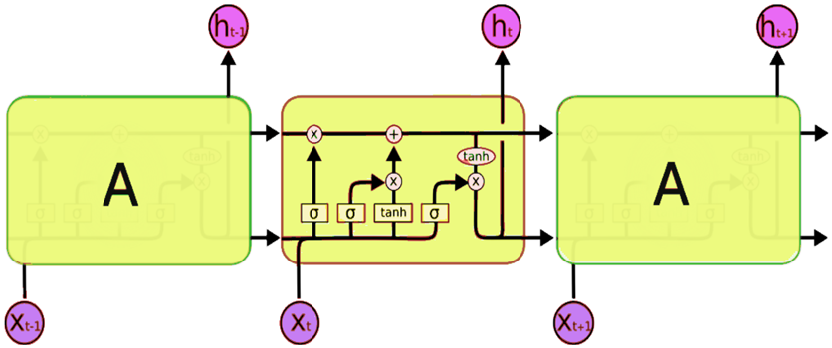
Deep Learning Techniques – Long Short-Term Memory (LSTM)
The LSTMs can remove or add information to the cell state by properly regulating gates.
In an LSTM, three gates protect and govern the cell state. In LSTM, the first stage is for a sigmoid layer known as the "forget gate layer" to decide what information should be discarded from the cell state.
The old cell state is then multiplied by forgetting the items and adding the new candidate's values to update the old cell state into the new cell state.
To begin, a sigmoid layer executes outputs based on the cell state.
The cell state is then passed through tanh and multiplied by the output of the sigmoid gate to output only the sections we want.
If the input gate value is small and close to zero, there will be no improvement in state cell memory.
Multiple LSTM layers can be used to implement stacked LSTM in a network model.
Because of the technique of forgetting and remembering information within a cell, LSTM is ideal for dealing with sequential data.

Slide 22
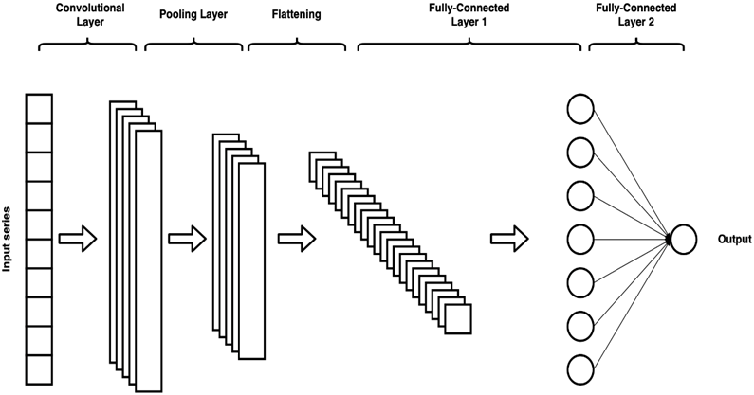
Deep Learning Techniques – Convolutional Neural Networks (CNNs)
CNNs are a type of deep learning network with a grid-like topology that is used for data processing.
This can include time series and image data, which can be represented as one-dimensional and two-dimensional data grids, respectively.
CNNs are known to boost the power of the ANN in load forecasting because they have deeper layers and model parameters such as receptive field length and dilation, which can help interpret load data better.
CNNs perform convolution by repeatedly applying filters or kernels to input data to create a feature map.
As a result, a CNN may repeat the convolution process in each network's convolution layers multiple times.
The ReLU activation function, like the sigmoid activation functions, squashes the inputs, clamping negative values to zero.

Slide 23
Deep Learning Techniques – Convolutional Neural Networks (CNNs)
In the third stage, a pooling procedure is used to smooth and minimize the dimensions of the resulting feature map.
The max-pooling method is commonly used; it returns an array of the maximum output values within the rectangle neighborhood of the previous layer.
Pooling layers is a technique for reducing the size of the previous layer's output.
As a result, the subsequent layer processes fewer inputs, resulting in increased computing efficiency.
The CNN network may contain one or more convolutional layers.
The outputs of the convolutional layers are received by the hidden or fully connected layers after they have been generated.
The output layer follows the hidden layer and serves the same function as an output layer in a typical neural network.

Slide 24
Implementation Specifications
The entire procedure was completed in MATLAB version R2021b.
Both the Toronto and Ottawa datasets have training datasets from 2010 to 2018, while the testing dataset is from 2019.
The Saint John dataset's training dataset spans the years 2018 to 2020, while the testing dataset spans the years January 2021 to the present.
The load demand is measured in megawatts, and the temperature is measured in degrees Celsius.
Outliers in the datasets were identified and replaced using the Hampel filter. We used the default median window in MATLAB, which contains the sample as well as six adjacent samples, three on each side.
We normalized the variables before passing them to the algorithms by using the datasets maximum and minimum values.

Slide 25
Implementation Specifications
This step was completed for both the load demand and temperature variables.
Data normalization, according to Panigrahi et al., has a significant impact on the performance of any model because its sole purpose is to ensure the quality of data before it is fed to the model.
The normalization method we used is known as Min-Max normalization; it scales values between zero and one; the normalized values are determined by their proximity to or separation from the set's minimum and maximum values.
Prior to calculating any performance metrics, the minimum and maximum values were saved and used to de-normalize the final forecasts.
This normalization method has been used by numerous researchers in the field of load forecasting.

Slide 26
Implementation Specifications – SNF and MLR
We used the previous week's hourly lag as the current hour's value in the seasonal naive method, which was simple to implement. We also repeated the previous step for each hour of our test set.
The MLR forecaster was created by combining ten independent variables, also known as inputs, and one target variable, which is the actual demand at a given hour.
Temperature, hour of the day, month of the year, day of the week – Sunday is the first day of the week, weekend indicator – one or zero, maximum hourly demand from the previous day, minimum hourly demand from the previous day, average hourly demand from the previous day, hourly lag from the previous day, hourly lag from the previous week are the independent variables.

Slide 27
Implementation Specifications – ARIMA
The following hyperparameters were used in the ARIMA model for the Toronto, Ottawa, and Saint John datasets, respectively: (24, 2, 25), (23, 2, 24), and (24, 2, 24).
We were able to determine p and q after much trial and error and using information from the partial autocorrelation and autocorrelation functions.
Finding the optimal number of differencing 'd' needed was relatively simple; we simply used the data's auto-correlation function to determine when it was under or over-differenced.
Our time series may still be under- or over-differenced at times. The first problem can be solved by adding one or more AR terms, and the second problem by adding one or more MA terms.

Slide 28
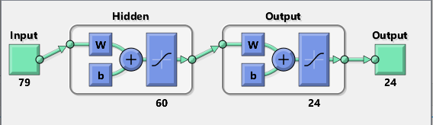
Implementation Specifications – ANNSTLF
The BLF and CLF networks are trained using the resilient back-propagation algorithm. This training method is effective, according to the MATLAB handbook, and is frequently used for pattern recognition problems.
We also discovered that this training method outperformed the Levenberg-Marquardt back-propagation method.
There are 60 neurons in the hidden layer.
The activation function in the hidden and output layers is a hyperbolic tangent sigmoid transfer function. When we changed the activation function of the output layer from linear to tangent sigmoid, we saw better results.
The training data was split into two groups, with 80% used for training and 20% used for validation.
The RLS combiner has an initial weight for each hour for both the BLF and CLF outputs; after each iteration, the weights for each hour are automatically updated based on the algorithm's calculation.

Slide 29
Implementation Specifications – ANNSTLF
As demonstrated in the section on artificial neural networks, the input set for ANNs consists of the following: the previous day's actual load (24 inputs), the previous day's actual temperature (24 inputs), the current day's actual temperature (24 inputs), and the current day's type (7 inputs containing ones and zeros).
Both the BLF and the CLF used the same set of inputs, but their target variables were distinct; the BLF focused on actual load demand, whereas the CLF focused on load changes from yesterday to today.
The final CLF forecasts were calculated by adding the predicted changes to the actual load from yesterday.
The BLF and CLF used a total of 79 inputs, as illustrated in the ANNSTLF architecture.

Slide 30
Implementation Specifications – LSTM
Other researchers on UNB's smart-grid team forecast load using the LSTM algorithm, but only on the Saint John dataset.
The implementation was modified to accommodate all of our datasets and input feature sets.
Furthermore, because the ANNSTLF structure was recognized as the best forecaster for short-term load forecasting, we emulated it by developing a Base Load Forecaster, a Change in Load Forecaster, and an RLS combiner using the LSTM algorithm rather than the ANN.
In terms of inputs and structure, the architecture was identical to the ANNSTLF, but the BLF and CLF algorithms were trained using LSTMs.
We were curious to see if this change would result in better forecasting performance.

Slide 31
Implementation Specifications – CNN
Using the ANNSTLF structure, we implemented the CNN algorithm in a manner similar to the LSTM.
The CNNs used in this study are composed of six layers: an input layer, a convolutional layer, a rectified linear unit activation layer (relu), a max-pooling layer, a fully connected layer, and a regression output layer.
The adam optimization training algorithm was used to train the CNNs.

Slide 32
Performance Metrics
This study will compare the performance of all forecasters across all datasets, taking into account overall performance as well as hourly, daily, monthly, and seasonal performance.
Forecast accuracy and peak load localization will be used to evaluate performance.
The simplest way to measure forecast error is mean absolute error (MAE), but because it is an absolute measure, it does not allow you to compare measurements across forecast scenarios of different scales.
As a result, Mean Absolute Percent Error (MAPE) is commonly used because comparison interpretation is simple.
The MAE and MAPE both run the risk of underestimating the impact of significant but infrequent errors. By focusing solely on the mean, we risk being caught off guard by a massive error.

Slide 33
Performance Metrics
We used the Root Mean Square Error to account for severe, unusual errors (RMSE).
Because RMSE is not proportional to the original error, it is more difficult to interpret.
While these metrics have limitations, they are simple tools for evaluating forecast accuracy.
The MAPE and RMSE were the primary focus of this study because they are the most commonly used metrics for load forecasting.
Because there are no values very close to zero in our datasets, the MAPE's limitations do not apply, and the RMSE allows us to detect large forecast errors.
In my thesis appendix, I provided data on the overall performance of all metrics, including the ones mentioned above.

Slide 34
Overall Performance – Toronto Dataset

Slide 35
Overall Performance – Ottawa Dataset

Slide 36
Overall Performance – Saint John Dataset

Slide 37
Daily Peak Performance
The mean absolute (MAE) and mean biased (MBE) time differences between the actual and forecasted occurrence times, as well as the mean absolute percentage difference (MAPE) between the actual and forecast peak values, will be calculated.
It is worth noting that the MAEs and MBEs of the time difference are denoted by minutes in the tables.
In terms of peak detection accuracy, it's worth noting that daily peaks are affected by a variety of random variables, making prediction difficult.
This is because random peaks can result in significantly higher peaks than regular peaks, and because we are calculating the daily maximum, we use the random peak rather than the regular peak.

Slide 38
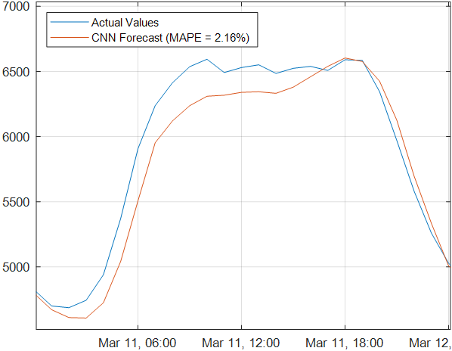
Daily Peak Performance
The Toronto dataset typically peaks in the evenings between 16:00 and 21:00, but as shown in the figure below, a random peak occurred at 10:00 with a value of 6594 MW, which was higher than the second highest peak at 18:00 with a value of 6590 MW.
The CNN, on the other hand, forecasted a peak at 18:00 with a value of 6603 MW.
The random peak influences our time difference MAE and MBE accuracy metric because we will compare the predicted time to the one at 10:00.This is just something to keep in mind when it comes to the algorithms' ability to detect peaks.
A significantly more accurate metric for comparing time differences could be used in future work.

Slide 39
Daily Peak Performance – Toronto Dataset

Slide 40
Daily Peak Performance – Ottawa Dataset

Slide 41
Daily Peak Performance – Saint John Dataset

Slide 42
Comprehensive Evaluation

Slide 43
Summary of Our Analysis

Slide 44
Contributions

Slide 45
Future Work

Slide 46
Thank you for your attention ☺
Merci pour votre attention ☺

